Slide 1
TOPIC 3
STREAM MINING: Bloom Filter and Count-distinct
Daniel Dadras 6641492

Slide 2
Bloom Filter
Data Structure to test whether an item is in a set or not:
1) Use hash functions to create bitmap of key set
2) Use hash functions to check if a new item is hashed anywhere that is already in use
Advantages:
  Easy to implement
  Space-efficient
  No false-negatives possible
Disadvantages:
  Probabilistic = can have false positives
  Items can be added to key set (just hash them), but removal is difficult

Slide 3
Flajolet-Martin algorithm
Algorithm to approximate number of distinct items in a stream:
1) Use hash functions to create bitmap of stream
2) Let R be the smallest position in bitmap that is unhashed
3) Estimate number of distinct items as 2^{R} / Φ with Φ ≈ 0.77351
Advantages:
  Easy to implement
  Space-efficient
Disadvantages:
  Results vary significantly based on hash function
  Susceptible to outliers

Slide 4
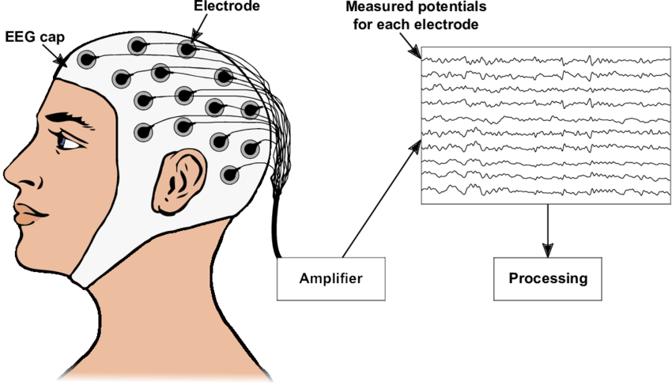
Dataset for a medical use case
EEG Eye-State Data
Measurements over 117 seconds
~ 15000 single measurements over 14 channels (≈90 measurements per second
+ Measurement indicating eyes open/closed
Values are floats/binary (eye state)
Source: https://www.researchgate.net/figure/Sketch-of-how-to-record-an-Electroencephalogram-An-EEG-allows-measuring-the-electrical_fig1_338423585

Slide 5
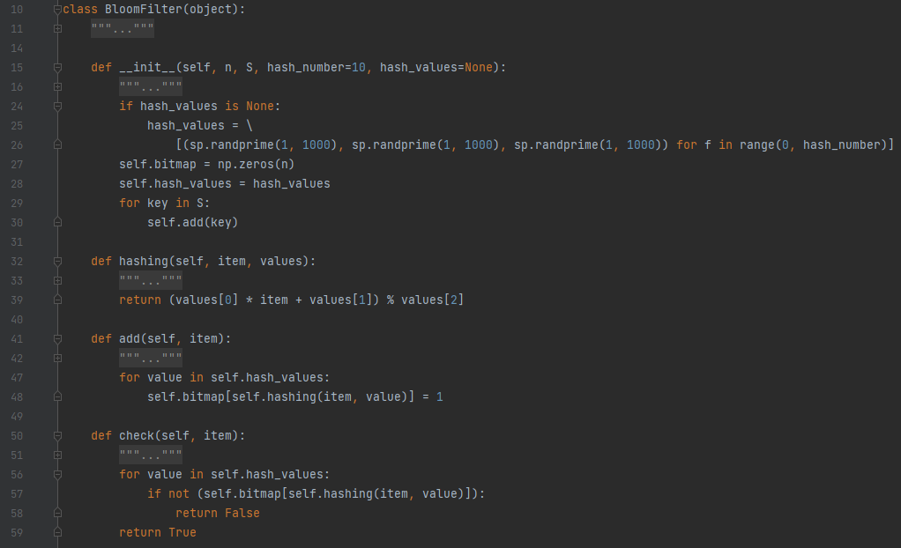
Bloom Filter Implementation
Variable number of hash functions
  Basic multiplicative hash function with random prime numbers
Initializes bitmap and hashes key set when first instantiated
Adding items to key set by simply hashing them into the bitmap
Filter itself: hashes item and compares with bitmap

Slide 6
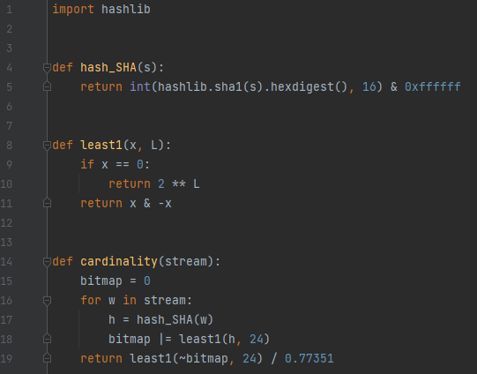
Flajolet-Martin implementation
Public implementation by Lucas Schmidt
For every item in stream:
1) hash the item and constrain every hashing to have 24 bits
2) return the first 1-bit of the binary representation of the hash
3) Calculate first 0-bit of bitmap and use that to approximate number of distinct items

Slide 7
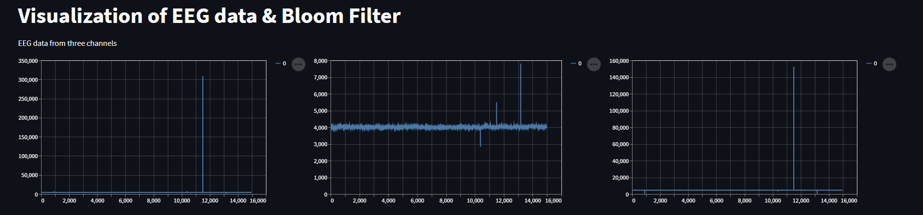
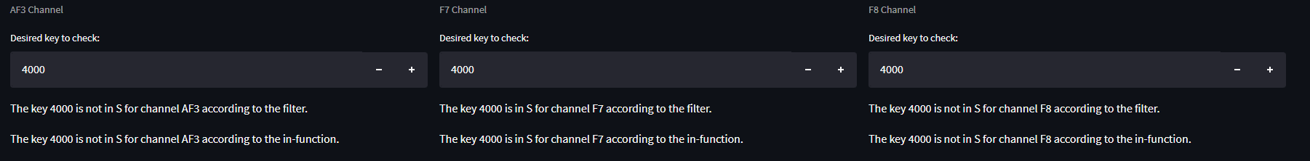
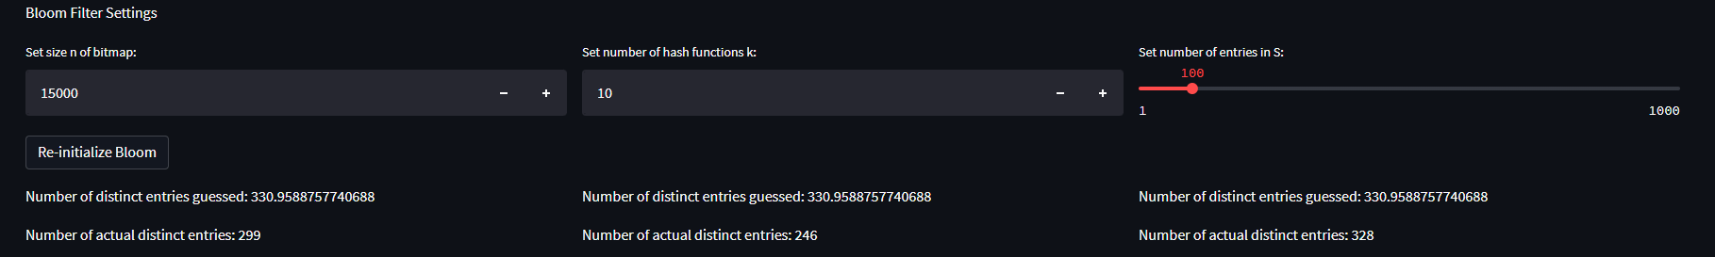

Slide 8
Github & References
Data Set: https://archive-beta.ics.uci.edu/ml/datasets/eeg+eye+state
Flajolet-Martin implementation: https://github.com/lucasschmidtc/Probabilistic-Algorithms/blob/master/Probabilistic%20Algorithms.ipynb
GitHub Link: https://github.com/Sworft/Data-Science-Topic-3

